Slide 1
eCIRTS Review for FCOA
Monica Reed, WellSky Implementation Consultant

Slide 2
Introductions
Jonathan Yeaton, Chief Information Officer, DOEA
Monica Reed, Senior Implementation Consultant, WellSky
Format

Slide 3
Topics To Cover
Mobile Assessment Demonstration
Improvement Suggestions from Provider Survey
Reports Training
Phase 2 Schedule Review

Slide 4
Available Resources
This presentation will be available in the next eCIRTS Newsletter
eCIRTS Training Manual V2 is available on the eLearning site

Slide 5
Mobile Assessment Demonstration

Slide 6
What is Mobile Assessments?
The tool you can use to complete assessments, either online or offline, using your mobile device: phone, tablet, or laptop.
After you download assessment form and client information to your device, you can create assessments even where no internet connection is available.
When you connect to the internet again, you can synchronize that assessment data into eCIRTS.
Download Clients to Device
Conduct Assessment
Synchronize to eCIRTS
No Internet
Internet
Internet
Internet

Slide 7
Before You Begin
Mobile Assessments is compatible with the following devices and browsers:
Windows/Mac/Linux devices:
  Microsoft Edge
  Google Chrome
  Firefox
  Safari
Mobile devices using the Apple Operating System (iOS®), such as the Apple iPhone & iPad
  iPhone 5+
  iPad 4th generation+
  iPad Mini
  Safari
Mobile devices using the Android™ Operating System
  Chrome 38+
  Firefox
All internet browsers should be recent versions (within the past year).
You can use a variety of mobile devices to access Mobile Assessments, but you should not download the same client records to more than one device at a time.
When you download client records, they are saved to the local device storage.
  NOTE: Older devices don’t have as much storage.
Use the same mobile device to update/add assessments to ensure that the data synchronizes correctly when you connect to the internet.
Your default role defined on your eCIRTS user account is the role you will use in Mobile Assessments. You cannot switch roles in Mobile Assessments.

Slide 8

Before You Begin
Use your device’s internet browser to open the Mobile Assessments URL, whether you are connected to the internet or not. To make access easier, save a browser bookmark or shortcut.
Log in using the same username and password as eCIRTS.
Mobile Assessments provides the ability to temporarily store client assessment information to your device, so you can conduct face-to-face assessments from any location without being connected to the internet.
Assessments that you conduct while your mobile device is connected to a cellular or network connection are synchronized with eCIRTS automatically.
Assessments that you conduct while offline can be synchronized with a single click the next time the mobile device is connected to the internet.
Deleting your browser cache / temporary internet files will permanently remove all assessment data
from your mobile device. If you delete your browser cache, any assessments that have not
been synchronized will be lost.
Notes:
Clearing your cache means deleting the information automatically stored to your device. You might do this if you are strapped for space on your device or if you've noticed it's performing slower than usual.
The cache remembers parts of pages, like images, to help them open faster during your next visit. After you clear cache some settings on sites get deleted. For example, if you were signed in, you’ll need to sign in again. If you were working on a form but haven’t synced, it will be deleted.

Slide 9
Before You Begin
It is important to manage the downloaded records on your mobile device. As a general rule, when you’re finished working with your client and their assessments, and you have successfully synchronized data, remove the record from your mobile device.
Removing records that you no longer need is significant for the reasons listed below.
  Records contain confidential information that needs to be safeguarded.
  If you keep many records on your mobile device, it can be time-consuming to synchronize them.
  Records accumulate and can take up valuable space on your device.
  When using mobile devices, it is easier to scroll through short, rather than long lists.

Slide 10
Download, Assess, Sync
If you plan to be offline to complete an assessment, before you conduct the assessment, you must download the client onto your device.
When you add records to your mobile device, a copy of the record is saved to the device.
You must have an internet connection to download clients.
Mobile Assessments has been designed for rapid data entry, allowing assessors to conduct face to face assessments as quickly as possible.
Synchronize one by one or in bulk from the Notifications queue.
Mobile Assessments will alert you when assessments have been created and not yet synchronized to the server.

Slide 11
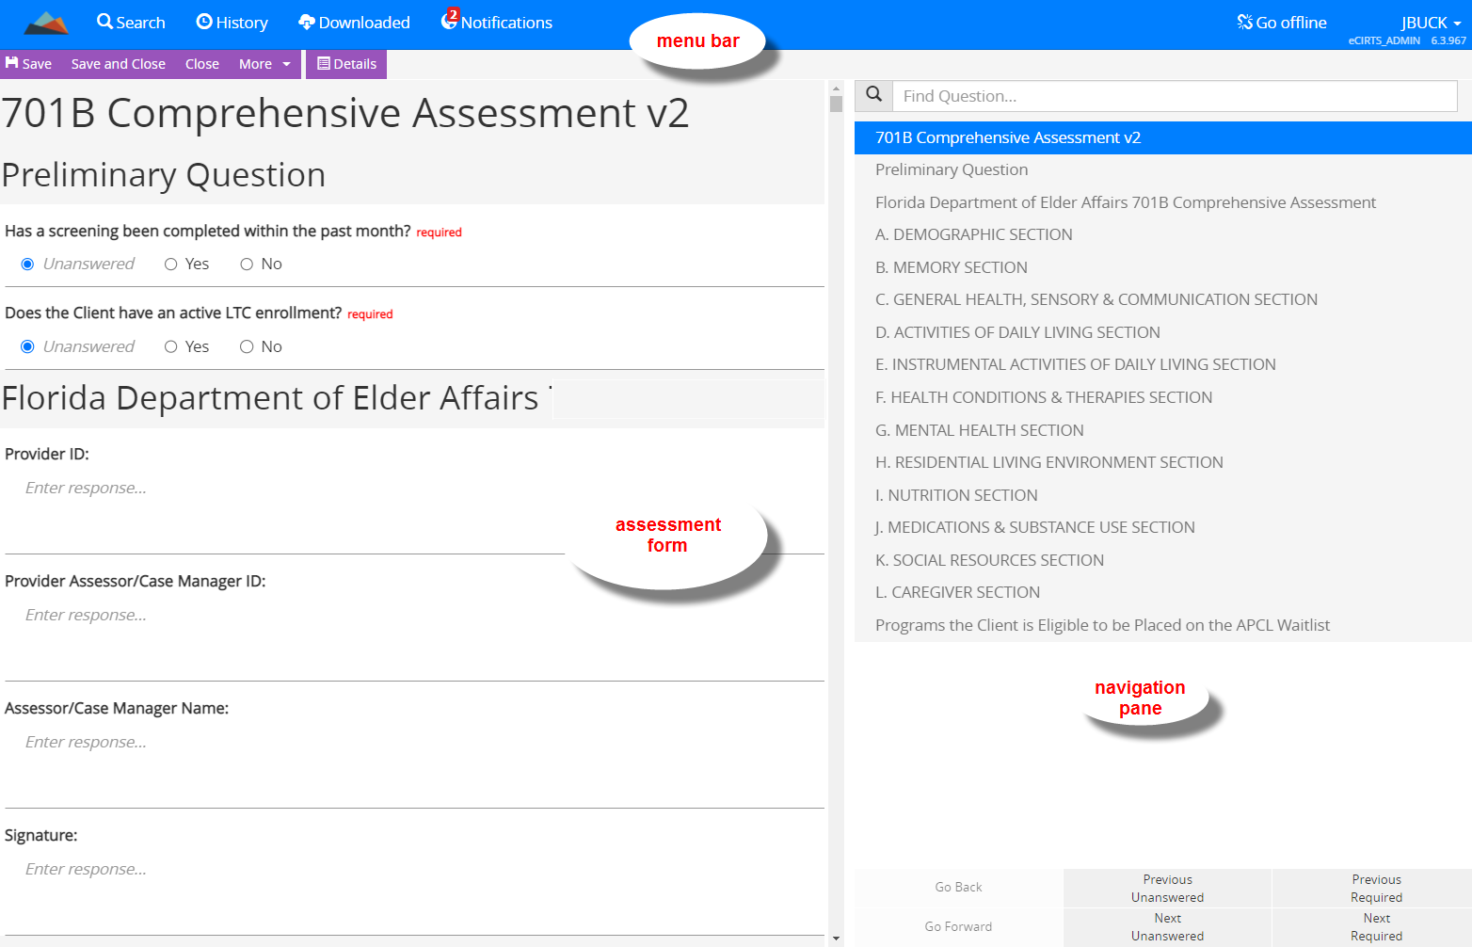
Working with Assessments
The Assessment Form window includes a menu bar at the top, the assessment form on the left side of the screen, and navigation options on the right side of the screen.
The assessment navigation panes at the bottom right side of the screen give you options for quickly navigating to specific areas of the assessment form.
  You can search by keyword, jump to form topics
  by title, or navigate to previous and next questions
  using the buttons at the bottom of the screen.
  You can also scroll through the questions using the
  scroll bar to the right of the questions.
  The navigation pane may not be visible when you
  are using a mobile device with a small screen.

Slide 12
Demonstration
Notes:
Add a New Form AND Edit an Existing Form.
Do one Online and the other Offline
Log in: https://ltssbhtr1.mediware.com/flecirts-sandbox-assessments/
Use Sandbox credentials
---first log in can take a bit of time. Subsequent ones will be faster.
Search for and Download clients
Can search by ID, Name, SSN, DOB, Medicaid ID
1412768> Make available offline
Downloaded tab:
Michele Apple: just downloaded
Laura Gilchrist: downloaded earlier
Go Offline
Edit Existing. Click OPEN from the name list.
Laura Gilchrist > existing 701A
Update some questions.
Click Details to return to the header info.
Save > Saved to device message displays.
Notification tab shows assessment that has not been synchronized
Go Online
Add New
Michelle Apple > New 701B.
Show how can Open existing and Select Copy to create a new one. Can do this online or offline.
Answer some questions. Save > Saved to database message displays.
Log into eCIRTS > 1412768 > Forms > See 701B
Return to Mobile Assessment: Notifications queue
Michelle Apple not in Notifications queue.
Laura Gilchrist from earlier is.
Sync Laura Gilchrist 701A
eCIRTS > 550272> Forms > See 701A

Slide 13
Summary
What is Mobile Assessments?
  A tool you can use to complete assessments, either online or offline, using your mobile device: phone, tablet, or laptop.
Before You Begin
  There are minimum requirements for devices and don’t clear your cache before you sync.
Download, Assess, Sync
  Internet required, not required, internet required
Working with Assessments
  Many form navigation options
Timeline for Production
  Fall 2022

Slide 14
Reports Training

Slide 15
Running Reports in eCIRTS
How to run a report
Things to avoid when running reports
Reporting issues or suggested changes to reports
Report demo recording

Slide 16
Improvement Suggestions

Slide 17
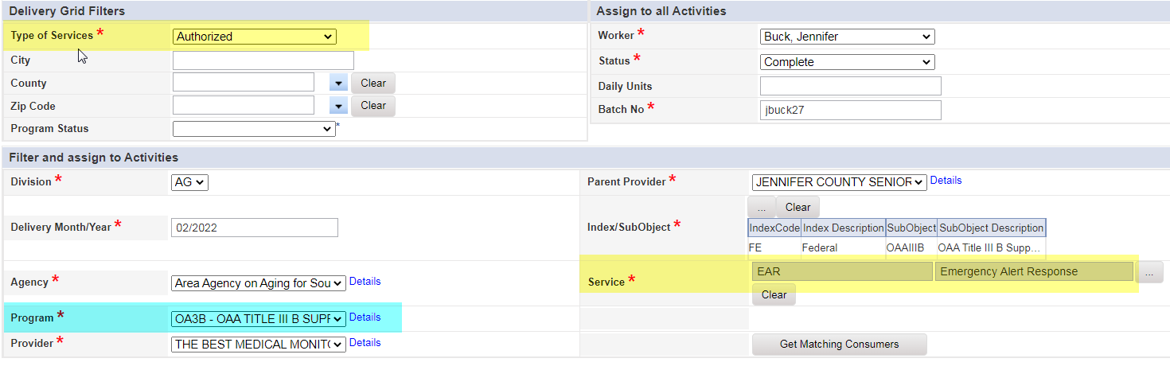
Activity Roster Filters
Suggestion:
Activity Roster actually narrowed down to the program and service.
Next Steps:
This can be done!
The client must have an authorization for the service first, on the Services tab.
The Activity Roster is filtered by clients who have an open program enrollment for the program selected on the roster AND if Type of Service = Authorized, only those with authorizations for the service selected on the roster.
Watch the Demo Days recording for a functionality review of all fields on the activity roster. You can also watch the Demo Days recording of Service and Care Plans for information on creating authorizations.

Slide 18
Search by Pseudo SSN
Suggestion:
Add a search box for Pseudo`s.
Next Steps:
The eCIRTS Task Force is one step ahead of you!
This field is not one that can currently be enabled as a search filter, but it has been asked for.
An enhancement request was already submitted to WellSky to add this field as a search filter. It will be available in a future build, but the timeline is still unknown at this point.

Slide 19
Fewer Drop-Down Menus
Suggestion:
Fewer drop-down menus; Allow type in choice not just drop down. Allow for direct data entry. Pick lists are take too long
Next Steps:
To improve the quality and consistency of data across PSAs and make for easier reporting, the eCIRTS Task Force purposely moved away from free text fields when converting CIRTS data into eCIRTS.
Structured phone, address, and lookup fields are throughout the application.
There are also several fields that cannot be changed because of their impact on eCIRTS checks and balances.
Watch the Demo Days recording for shortcuts when navigating long lookup lists, specifically on the Activity and Activity Roster pages.

Slide 20
Need More Training Opportunities
Suggestion:
Need more training opportunities. More frequent in-person training for new employees and refreshers for existing employees.
Next Steps:
Please connect with your Super User. Each PSA has one or more Super Users. They know a lot!
Super Users from all PSAs meet weekly and discuss refinements to eCIRTS as well as training opportunities.
We have completed several rounds of training across the state for topics suggested by the Super Users since go live. The following manuals and recordings are available:
Build Update for eCIRTS Version 8.6.3
Case Closure Process
Demo Days: Contracts and Contract Services for AAA Fiscal Officers
Demo Days: Entering Billable Services
Demo Days: Services and Care Plans
Introduction to Mobile Assessments
Provider Contracts and Contract Services
Provider Service Packages
Resolving Provider Billing Issues
Role Updates August 2022
Service and Care Plan Clean Up
Terminate - Billing Status Use
Updating Migrated Services for 'Historical Provider'

Slide 21
Streamline the Enrollment Process
Suggestion:
Streamline the enrollment process.
Next Steps:
To assist providers with their spending plans, ensuring they do not go over their contracted funds, and aid the AAAs and providers in monthly surplus/deficit discussions, eCIRTS has substantially more checks and balances for billing than legacy CIRTS. There are steps/fields that cannot be removed from the enrollment process because of their impact on eCIRTS checks and balances.
The Super Users and System Change Task Force has been and will continue to refine the workflows in the application like they’ve done since January 2022. This results in ‘less click' workflows. If you have suggestions for improvement, please let your Super User know!
Watch the Demo Days recording for required setup for the checks and balances that impact the enrollment process.

Slide 22
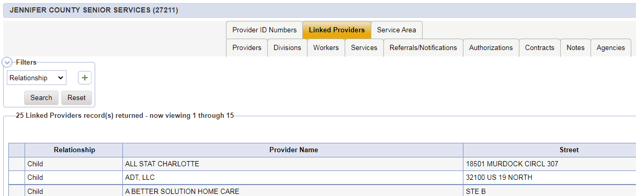
Parent Status of Lead Agencies
Suggestion:
Please re-configure eCIRTS to restore the “parent” status of the lead agencies. We have 30 service providers providing 9 different services for 3 different programs, for a total of 139 monthly invoices/reports. Due to the way eCIRTS is configured, we have to run 139 separate reports each month. Is it possible to configure the system so that the lead agency is the “parent” and we could pull congregate reports?
Next Steps:
We cannot go back to the CIRTS structure but you can get what you need by updating the reports.
If a provider can be contracted to provide services and submit billable units, then they MUST have their own provider record in eCIRTS. These provider record will be associated to each other as parent/child(locations) through linked relationships.

Slide 23
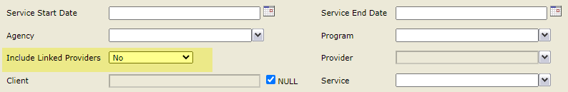
Parent Status of Lead Agencies
Next Steps:
When it comes to reports, they can be updated to include/exclude linked providers (see the Activity Record Data report as an example.)
Instead of running a report 139 times, you can check the flag to include linked providers, run the report for the parent and all activities for that parent's children will also display on the report.
Please let your Super User know which reports would benefit from this update. The DOEA Report Writing team works closely with the Super Users to update reports.

Slide 24
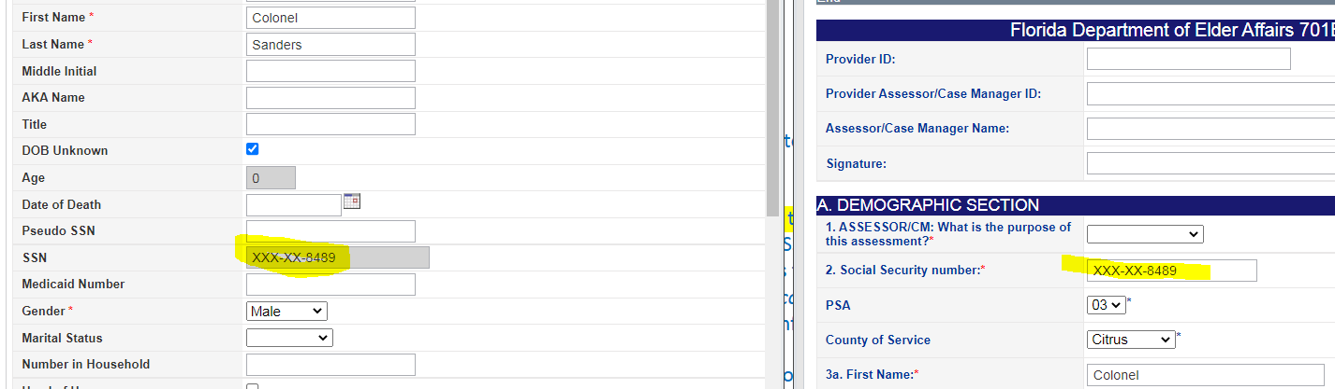
Updating SSN After Assessment Completed
Suggestion:
Updating SS# after Assessment completed.
Next Steps:
Only those with the SSN Manager role can view the unmasked SSN and change it on the Demographics page.
Recently, we expanded the ability for users to update the SSN for a client, but it is done from the 701S.
Anyone with access to a 701S can add/update the SSN on the form and when saved, it will update the SSN on the Demographics page.
Users should inform their supervisor when updates are needed rather than reversing the status of the 701S form and making the changes themselves.

Slide 25
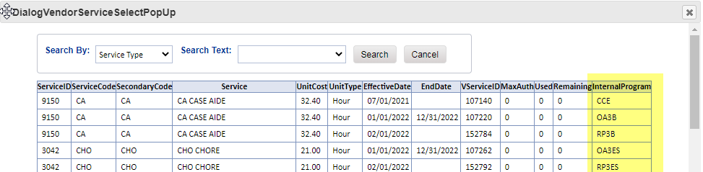
Activity Auto Fill
Suggestion:
After narrowing down program, that the activity will auto fill with correct program for the service.
Next Steps:
There are several fields that cannot be changed because of their impact on eCIRTS checks and balances, program and service are 2 of these fields.
The program is pulling from the open client enrollments. The service is pulling from active provider services. Both are needed before you can enter units. The value of one will not/cannot define the value of the other.
Good news is the updates being made to eCIRTS on 8/28/22 will now display the program of the service, so you can pick the right one. You’ll be able to get rid of those Service Crosswalk spreadsheets!
Watch the Demo Days recordings for details on the fields of an Activity record and the checks and balances in eCIRTS. You can also watch the recording on the upcoming eCIRTS Build Updates to see the new Program column.

Slide 26
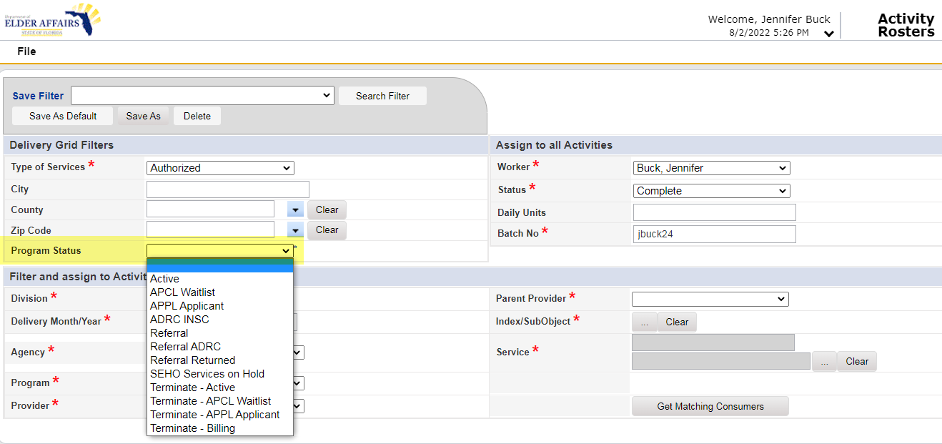
Active Program Appears on Roster
Suggestion:
That only the active program for client appears on roster, not all including what`s on waitlist for too.
Next Steps:
If there is more than one open program record for the client for the program selected on the Roster, the client will be listed twice in the roster search results.
    i.e. active for OA3B for CHO but APCL for OA3B for HMK.
eCIRTS is being updated on 8/28/22 with a new and improved Activity Roster. A Program status filter has been added. You can filter this down to one using the new Program Status filter.
Watch the recording on the upcoming eCIRTS Build Updates to see the new program status filter.

Slide 27
Client Service Ticklers
Suggestion:
Ticklers should not trigger when making corrections to client services.
Next Steps:
A tickler will trigger for every service that is saved with status = Accepted, reminding you to confirm with the client that services have started. One tickler per service will trigger.
This is a perfect topic for the Super User/Systems Change Task Force.
Please let your Super User know this process needs to be revisited. It will be added to an upcoming Thursday Super User meeting where a recommendation will be made. Then on to the Systems Change Task Force the following Tuesday for approval.

Slide 28
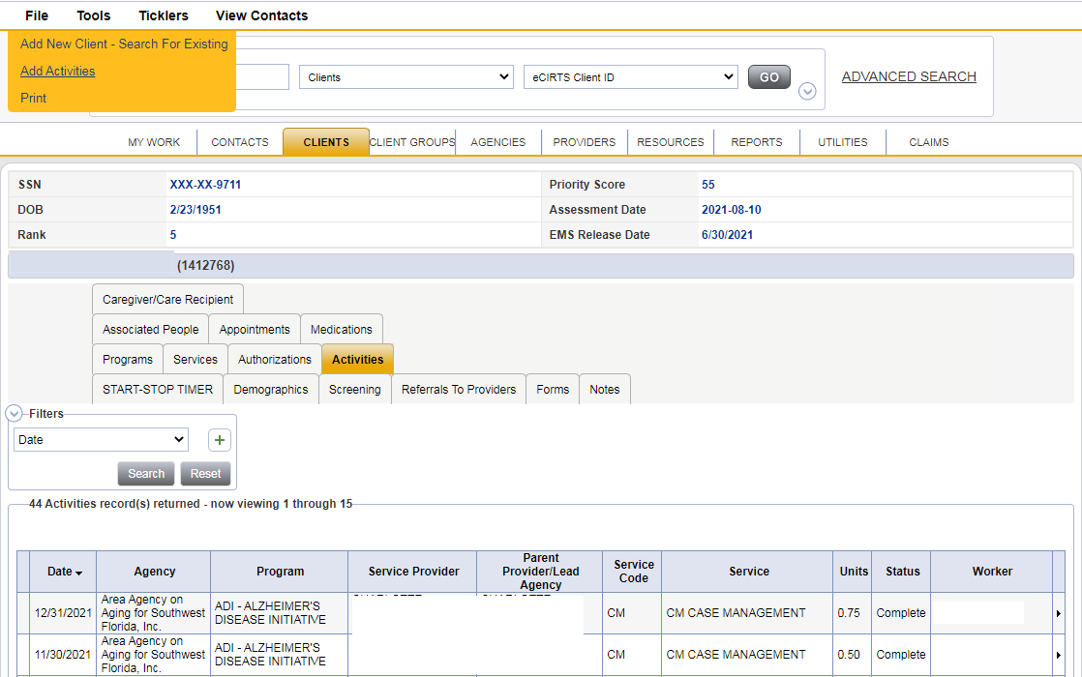
Unit Posting Role Default Screen
Suggestion:
The unit posting role should automatically default to the entry screen for the client after entering in cCIRTS ID #. Having to go click activities then file to add an entry is time consuming.
Next Steps:
Unfortunately, this functionality is not available in eCIRTS.
Users will land on a list/summary view first, not directly on a data entry screen, like the Activity page. eCIRTS doesn’t assume you always want to add a new record. What if you needed to edit one instead?
Good news is going from the Client’s Demographic page to the Activity details page takes two clicks and 3 seconds.

Slide 29
MLTC Information
Suggestion:
MLTC current and accurate information such as LOC, MLTC current enrollment status.
Next Steps:
WellSky and DOEA are actively working on the MLTC upload process and import logic. This import adds and/or activates MLTC and PACE enrollments in eCIRTS based on data provided by AHCA.
Dozens of rounds of testing have been completed and we are working through the final scenario.
In June 2022, DOEA started providing MLTC spreadsheets so PSAs would know which clients are MLTC active, until this import is complete.
We are targeting September 2022 for having the MLTC upload process complete and accurate in eCIRTS.

Slide 30
Automatic Referral to Provider Record
Suggestion:
Automation of manual tasks that are prerequisites to the main objectives. Such as the creation of referrals in order to have a client be pulled in an activity roster.
Next Steps:
The existence of that referral to provider record controls WHEN a provider can start billing for a client. You don't give them 'access' until the program is active.
Because of the ‘power’ this referral to provider record holds, DOEA has decided it will remain a manual process… a user consciously creating it vs. an automated process.

Slide 31
Implementing Changes
Suggestion:
Easier flow of implementing, adding, changes to eCIRTS.
Next Steps:
Implementing changes to the look and feel of eCIRTS is easy and one of the reasons the system was purchased by DOEA. There is no special coding or program knowledge required.
Actually, changes/improvements are happening almost weekly through the change control process led by your Super Users and the System Change Task Force.
eCIRTS is one system for all. Solutions are standardized across the state whenever possible, which can sometimes take some time and levels of approval, but once a decision is made, implementing the change is quick.
Please contact your Super User with a specific change request or to follow up on the status of a request you have already made.

Slide 32
Bulk Enrollment Options
Suggestion:
Bulk enrollment options (e.g. for disaster grants/ 1X grants to be able to do mass enrollments)
Next Steps:
eCIRTS is very client/provider focused. There are limited bulk entry options. The ability to add enrollments in bulk doesn’t currently exist within the application.
BUT, through the use of custom scripts, it can happen. Your Super User would work with the DOEA IT team through a Help Desk ticket for these requests.

Slide 33
Phase 2 Schedule Review

Slide 34
Phase 2 Schedule Review
Group 1
Design
Sept 22 – Dec 22
Technical
Sept 22 – May 23
Build
Dec 22 – Feb 23
Test
Feb 23 – Jun 23
Train
Apr 23 – Sept 23
Go Live
Sept 23
Group 2
Design
Sept 22 – Nov 22
Technical
Sept 22 – Apr 23
Build
Nov 22 – Feb 23
Test
Feb 23 – Jun 23
Train
Mar 23 – Aug 23
Go Live
Aug 23
Group 3
Design
Sept 22 – Nov 22
Technical
Oct 22 – Dec 23
Build
Dec 22 – Feb 23
Test
Oct 23 – Jan 24
Train
Dec 23 – May 24
Go Live
Jun 24
Group 4
Design
Oct 22 – Nov 22
Technical
Nov 22 – May 23
Build
NA
Test
Mar 23 – Jun 23
Train
Jul 23 – Dec 23
Go Live
Dec 23

Slide 35
Summary
The materials from this presentation will be available in the eCIRTS Newsletter on 8/24/22 or 8/31/22. It will include the link to the report training.
If you have additional suggestions for eCIRTS, please let your Super User know!
If you are encountering issues with eCIRTS or reports, please let your Super User know. If he/she cannot resolve the issue, a DOEA Help Desk ticket will be opened. DOEA IT and WellSky assist the Super Users with Help Desk Tickets.

Slide 36

Thank you for your time!

